Slide 1
Why does Wind Speed Increase with Height?

Slide 2
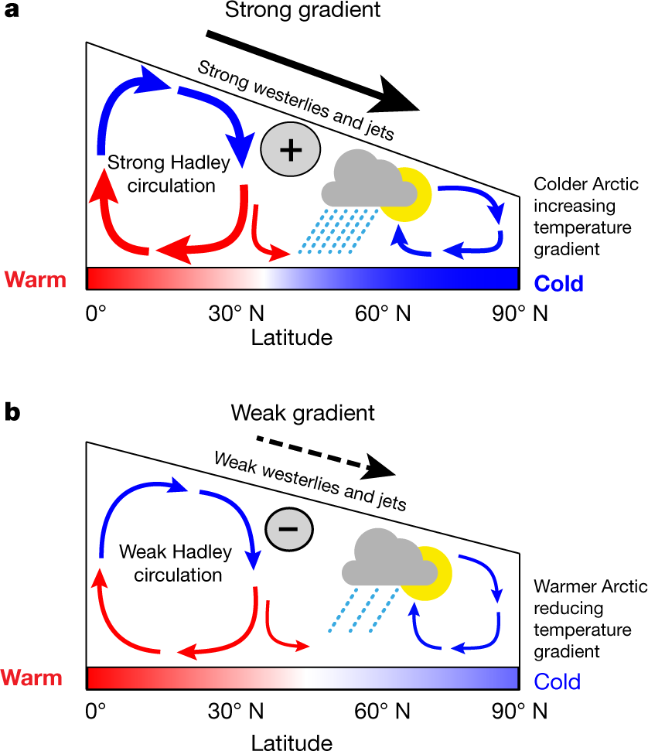
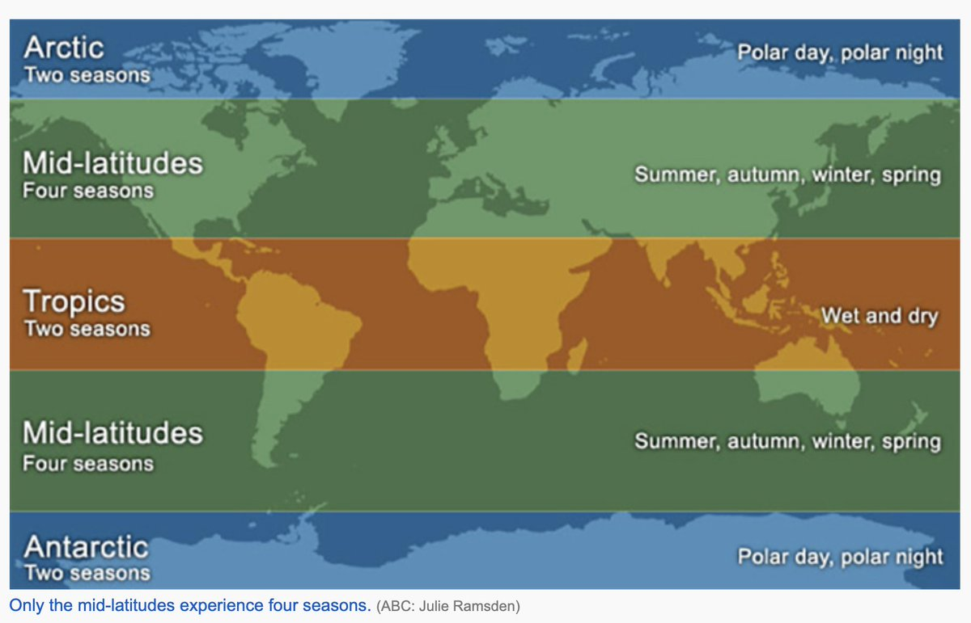
Mid-Latitudes
The Continental US lies in the “mid-latitudes”, which is the region of the Earth between the Tropics and the Arctic.
In the Northern Hemisphere, this means there will be warm air to the south (due to excess solar heating) and cold air to the north (due to excess cooling).
This leads to a relatively constant north-south pressure gradient and a prevailing wind from the west. Hence, “westerly” flow.

Slide 3
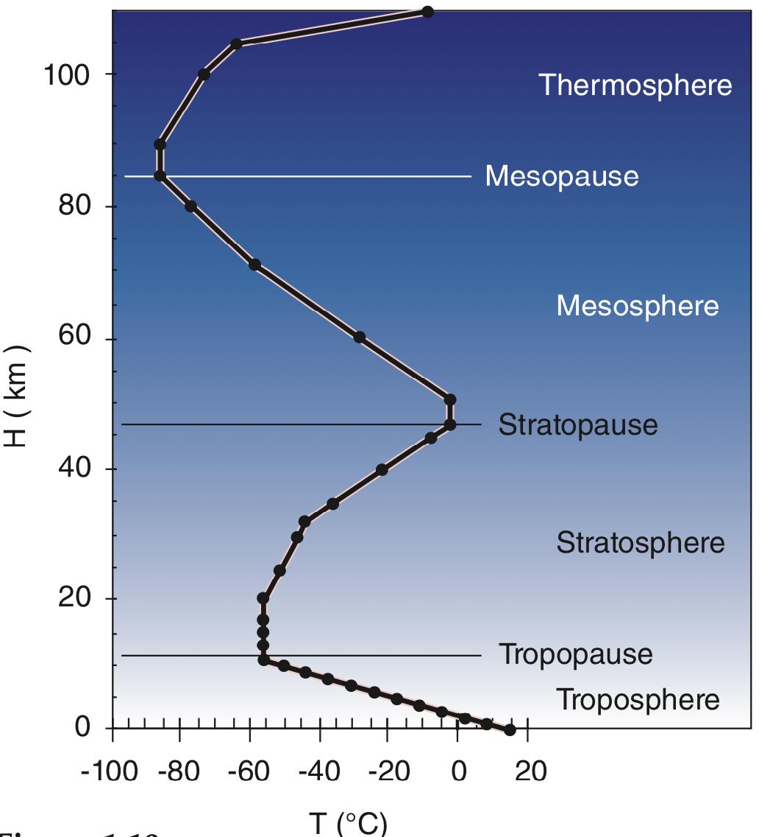
Atmospheric Height in the Mid-Latitudes
As you go higher in the atmosphere in the mid-latitudes, the north-south temperature gradient increases in strength.
This then leads to a stronger pressure gradient and higher wind speeds with height.
Wind Speed Increases the higher up you go

Slide 4
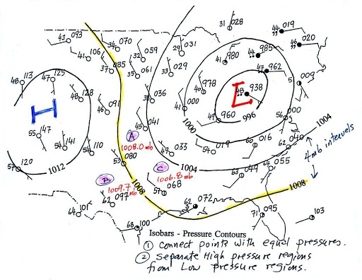
Constant Pressure Level
For analysis purposes, meteorologists usually look at the altitude of a constant pressure level (a.k.a., “isobaric” surface) instead of the pressure at a given height.
Makes analysis of winds the same as fluid moving over a topographic surface.

Slide 5
Planetary Boundary Layer
Since friction only influences the atmosphere close to the surface, in a layer called the Planetary Boundary Layer (PBL), meteorologists can ignore friction above this level.
Usually the PBL extends up to around the 850 mb isobaric level.
We can look at maps at different levels to get a general understanding of how pressure and winds change throughout the atmosphere.

